Slide 1
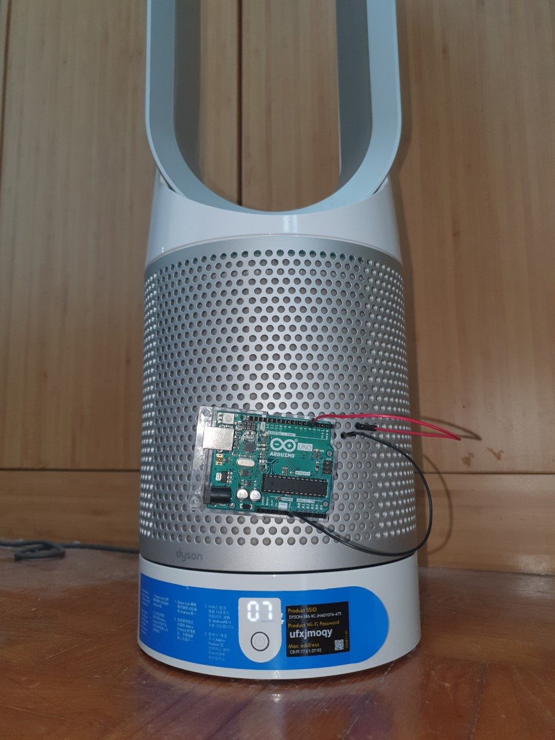
Speed Control of DC Motors
Jianning Zhuang

Slide 2
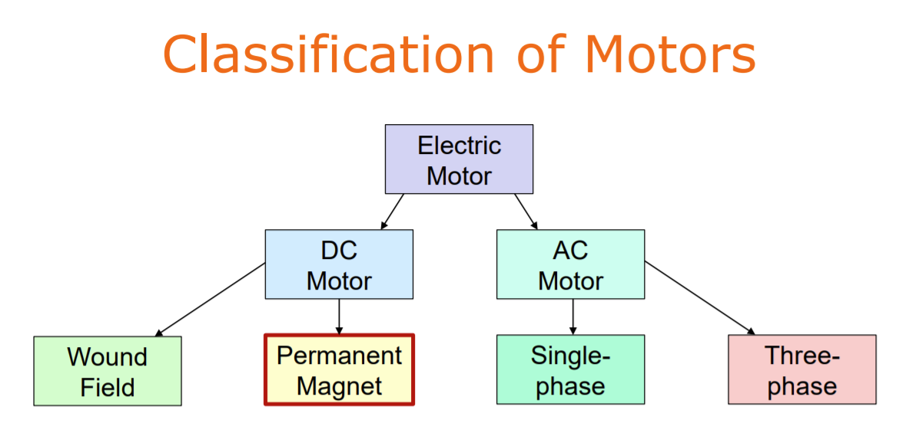
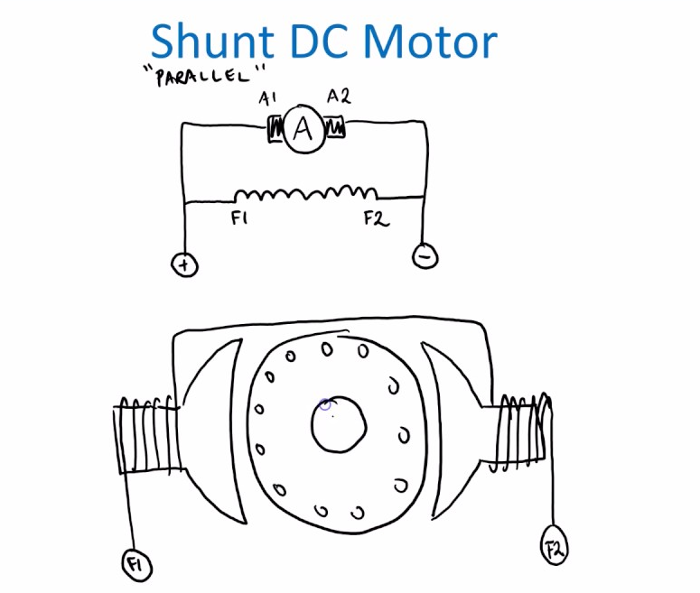
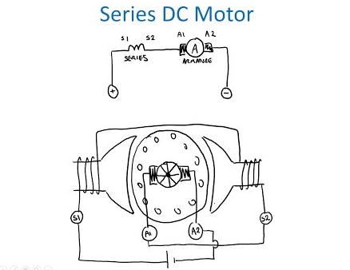
[1]
[2]
Notes:
https://www.youtube.com/watch?v=gSCv0rj2uYs
https://www.youtube.com/watch?v=6RAE-Y7cQG0

Slide 3
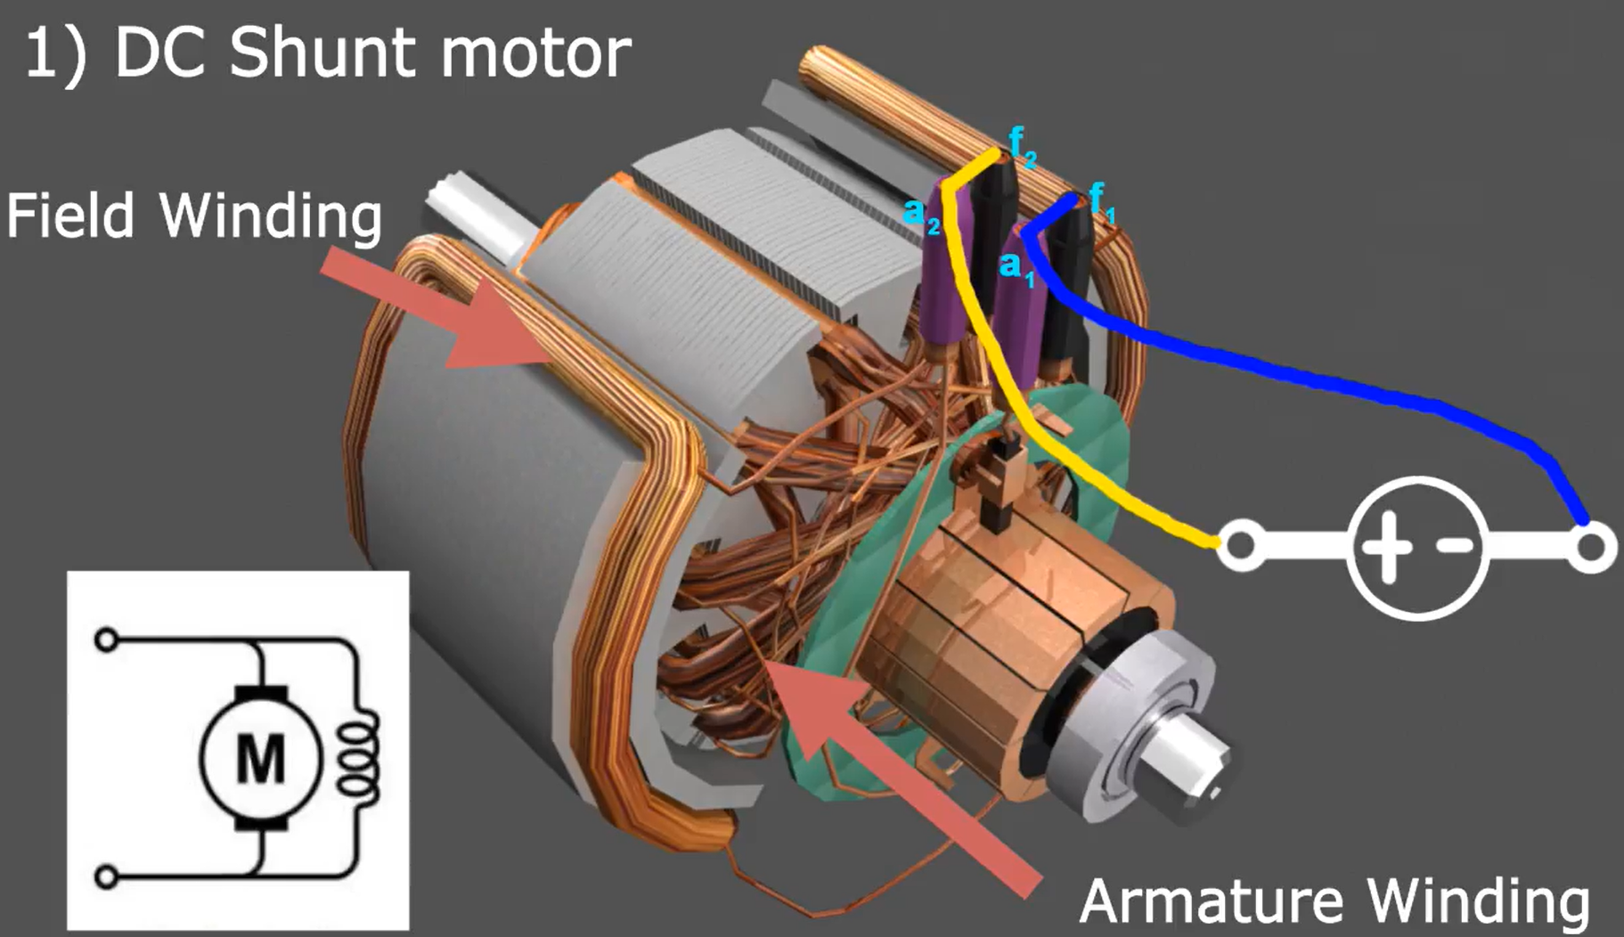
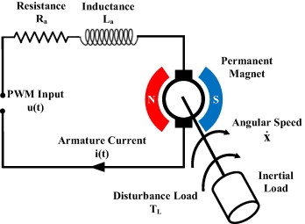
Permanent Magnet DC Motor
DC Shunt Motor
[3]
[4]
Notes:
https://www.sciencedirect.com/science/article/abs/pii/S0957415815000549
https://www.youtube.com/watch?v=TnZAHlyW1E8

Slide 4
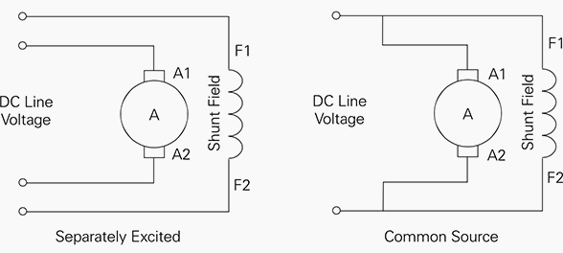
Circuit Equivalent of DC Shunt Motor
[5]
Notes:
https://electrical-engineering-portal.com/4-types-of-dc-motors-and-their-characteristics

Slide 5
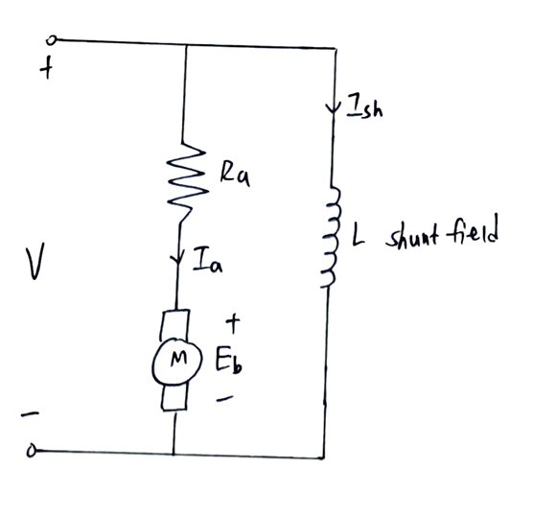




Deriving Speed Equation of DC Shunt Motor
$V={ { E_{b}+ I}_{a}R_{a}}_{}$
$$E_{b}= k_{e}∅ω$$
$$E_{b}= \frac{P∅NZ}{60A}$$
$ω=\frac{V − I_{a}R_{a}}{k_{e}∅}$
[6]
Notes:
https://electronics.stackexchange.com/questions/339089/how-to-find-armature-current-in-dc-shunt-motor-in-given-question

Slide 6
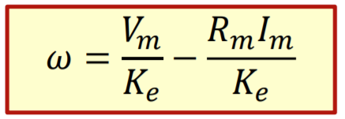
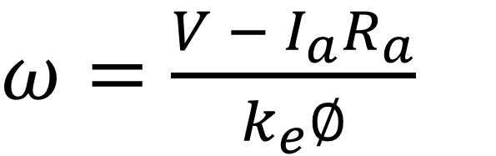
Recall the speed equation for PMDC motors
$ω=\frac{V − I_{a}R_{a}}{k_{e}∅}$

Slide 7
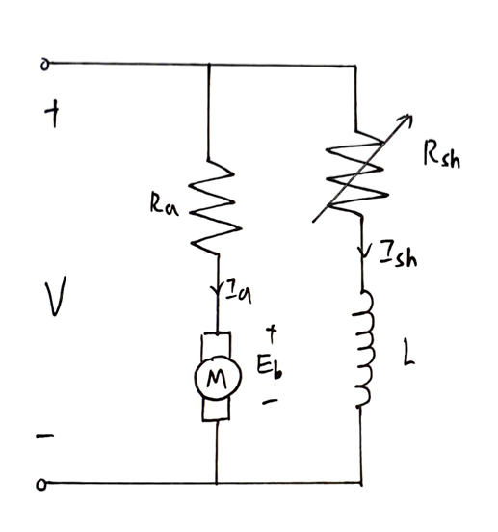






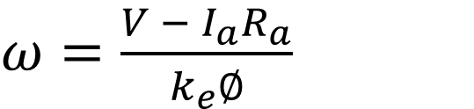

$ω=\frac{V − I_{a}R_{a}}{k_{e}∅}$
1) Flux Control Method
$R_{sh}$
$$I_{sh}$$
$$I_{sh}$$
$$∅$$
$$ω inversely proportional to ∅$$
$$∅$$
$$ω$$
Notes:
https://www.electricaltechnology.org/2020/05/speed-control-dc-motor.html#advantages-disadvantages-if-ward-leonard-method

Slide 8
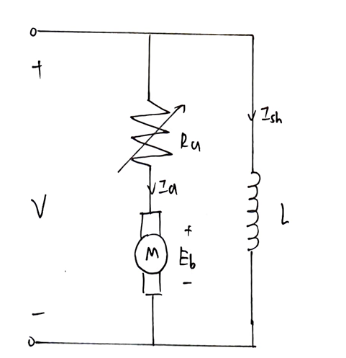




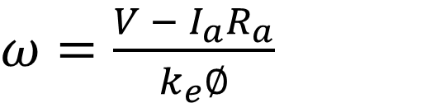
2) Armature Control Method
$ω=\frac{V − I_{a}R_{a}}{k_{e}∅}$
$$T_{a}= k_{T}I_{a}∅$$
$$ω= \frac{V}{k_{e}∅} − \frac{R_{a}}{k_{e}k_{T}∅^{2}}T_{a}$$
$$R_{a}$$
$$ω$$
[7]

Slide 9
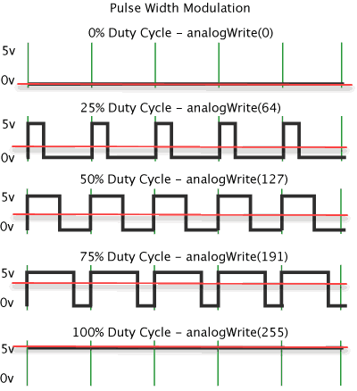
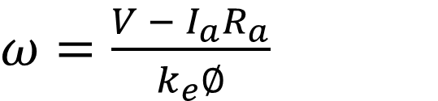

3) Voltage Control Method
$ω=\frac{V − I_{a}R_{a}}{k_{e}∅}$
$$ω is proportional to V$$
[8]

Slide 10
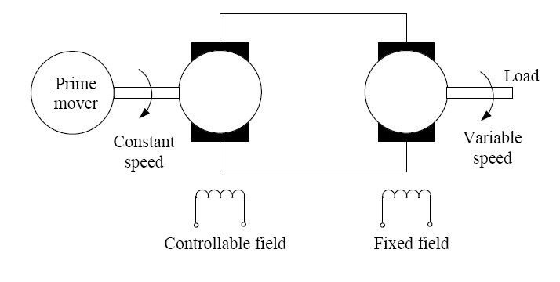
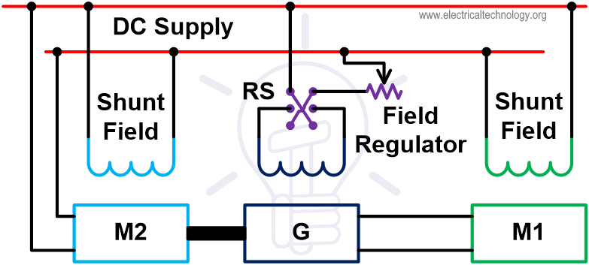
Ward Leonard System
[9]
[10]
Notes:
http://mypages.iit.edu/~qzhong2/ACDrive_web/ACDrive_web.html

Slide 11
Speed Control
Flux Control | Armature Control | Voltage Control
Only produce speeds higher than original rated speed Lowest speed when variable R is 0 | Only produce speeds lower than original rated speed Highest speed when variable R is 0 | Can operate at any speed up to maximum Bi-directional Smooth change in speed
Notes:
https://www.electricalengineeringinfo.com/2014/03/speed-control-of-dc-motors.html#:~:text=Advantages%20of%20flux%20control%20method,the%20load%20on%20the%20machine.

Slide 12
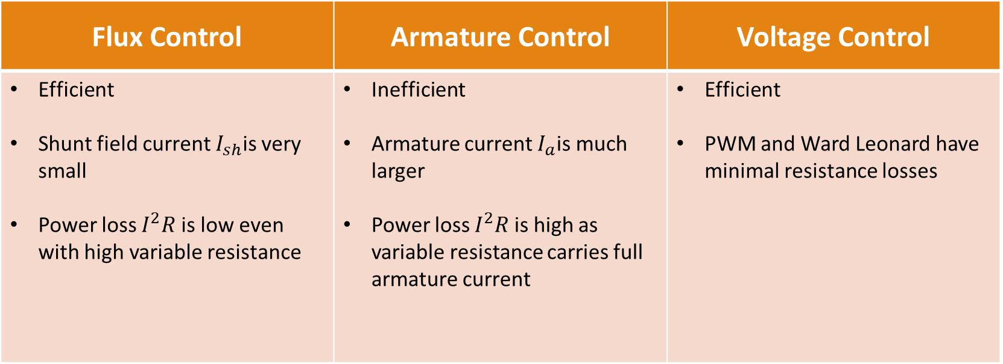
Efficiency
Flux Control | Armature Control | Voltage Control
Efficient Shunt field current $I_{sh}$is very small Power loss $I^{2}R$is low even with high variable resistance | Inefficient Armature current $I_{a}$is much larger Power loss $I^{2}R$is high as variable resistance carries full armature current | Efficient PWM and Ward Leonard have minimal resistance losses

Slide 13
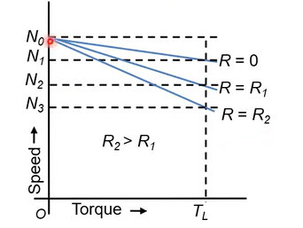
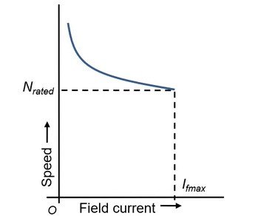
Other Limitations
Flux Control | Armature Control | Voltage Control
Limit on maximum speed Low current/flux may case speed to become dangerously high Instability and poorer commutation | Poor speed regulation | Ward Leonard system requires a special motor-generator set Higher cost Larger size and weight
[12]
[11]

Slide 14
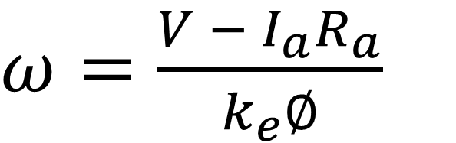



Summary
$ω=\frac{V − I_{a}R_{a}}{k_{e}∅}$
Flux Control Method Armature Control Method Voltage Control Method
$$∅$$
$$R_{a}$$
$$V$$

Slide 15
References
[1] Petre Vree. “Shunt DC Motor Connections," YouTube, Dec 18, 2016. [Video file]. Available: https://www.youtube.com/watch?v=6RAE-Y7cQG0. [Accessed: Oct 4, 2020].
[2] Petre Vree. “Series DC Motor Connections," YouTube, Dec 17, 2016. [Video file]. Available: https://www.youtube.com/watch?v=gSCv0rj2uYs. [Accessed: Oct 4, 2020].
[3] Rashidi, B., Esmaeilpour, M. and Homaeinezhad, M., 2015. Precise Angular Speed Control Of Permanent Magnet DC Motors In Presence Of High Modeling Uncertainties Via Sliding Mode Observer-Based Model Reference Adaptive Algorithm. [online] Science Direct. Available at: <https://www.sciencedirect.com/science/article/abs/pii/S0957415815000549> [Accessed 5 October 2020].
[4] Sourabh Sharma. “Types of DC Motors," YouTube, Aug 11, 2018. [Video file]. Available: https://www.youtube.com/watch?v=TnZAHlyW1E8. [Accessed: Oct 4, 2020].
[5] Csanyi, E., 2015. 4 Types Of DC Motors And Their Characteristics. [online] EEP - Electrical Engineering Portal. Available at: <https://electrical-engineering-portal.com/4-types-of-dc-motors-and-their-characteristics> [Accessed 5 October 2020].
[6] Daware, K., 2014. Speed Control Methods Of DC Motor. [online] Electricaleasy.com. Available at: <https://www.electricaleasy.com/2014/01/speed-control-methods-of-dc-motor.html> [Accessed 6 October 2020].
[7] Teresa, O., “DC Drives," Power Electronics and Drives, pp. 509-547, 2018. [Online]. Available http://www.philadelphia.edu.jo/academics/mlazim/uploads/ chapter11pdf. [Accessed 6 October 2020].
[8] Heath, J., 2017. PWM: Pulse Width Modulation: What Is It And How Does It Work?. [online] Analog IC Tips. Available at: <https://www.analogictips.com/pulse-width-modulation-pwm/> [Accessed 6 October 2020].
[9] Moore, R. and Drakos, N., 2008. AC Ward Leonard Drive Systems. [online] Mypages.iit.edu. Available at: <http://mypages.iit.edu/~qzhong2/ACDrive_web/ACDrive_web.html> [Accessed 6 October 2020].
[10] ELECTRICAL TECHNOLOGY. 2020. Speed Control Of DC Motor - Voltage, Rheostatic & Flux Control Methods. [online] Available at: <https://www.electricaltechnology.org/2020/05/speed-control-dc-motor.html#advantages-disadvantages-if-ward-leonard-method> [Accessed 6 October 2020].

Slide 16
References
[11] Athul R Padke. “Speed control of DC shunt motors," YouTube, May 1, 2020. [Video file]. Available: https://www.youtube.com/watch?v=BtPUCuR3XQE. [Accessed: Oct 4, 2020].
[12] ELECTRICAL TECHNOLOGY. 2020. Speed Control Of DC Motor - Voltage, Rheostatic & Flux Control Methods. [online] Available at: <https://www.electricaltechnology.org/2020/05/speed-control-dc-motor.html#advantages-disadvantages-if-ward-leonard-method> [Accessed 6 October 2020].

